Slide 1
SCHOOL OF MANAGEMENT
Renewable Energy · 2026
Solving India's evening peak — a renewables, storage and policy blueprint
THE PROBLEM IN FOUR NUMBERS
241 GW
150 GW
2025 Peak Demand
Solar Installed
A complete data-driven study using 9 official Govt of India datasets, 5 quantitative models (SARIMAX · EOQ · LP · K-Means · BESS), and 4 years of CEA/POSOCO records. Findings and recommended actions to 2030.
0 GW
350 GWh
Solar at the 8 PM Peak
National Storage Gap
CEA
POSOCO
NPP / MoP
IDP (ISB/BMGF)
CICERO
Open Data API
9 Datasets · 2001–2026
The capacity gap is closed. The timing gap remains — binding constraint on India's clean transition.
01 Problem
02 Data
03 Diagnosis
04 Models
05 Economics
06 Policy
Operations Management & Managerial Economics Engagement · 4 Weeks · Sources: CEA · NPP · POSOCO · IDP (ISB/BMGF) · CICERO
April 2026 Document V1.0 · Confidential

Slide 2
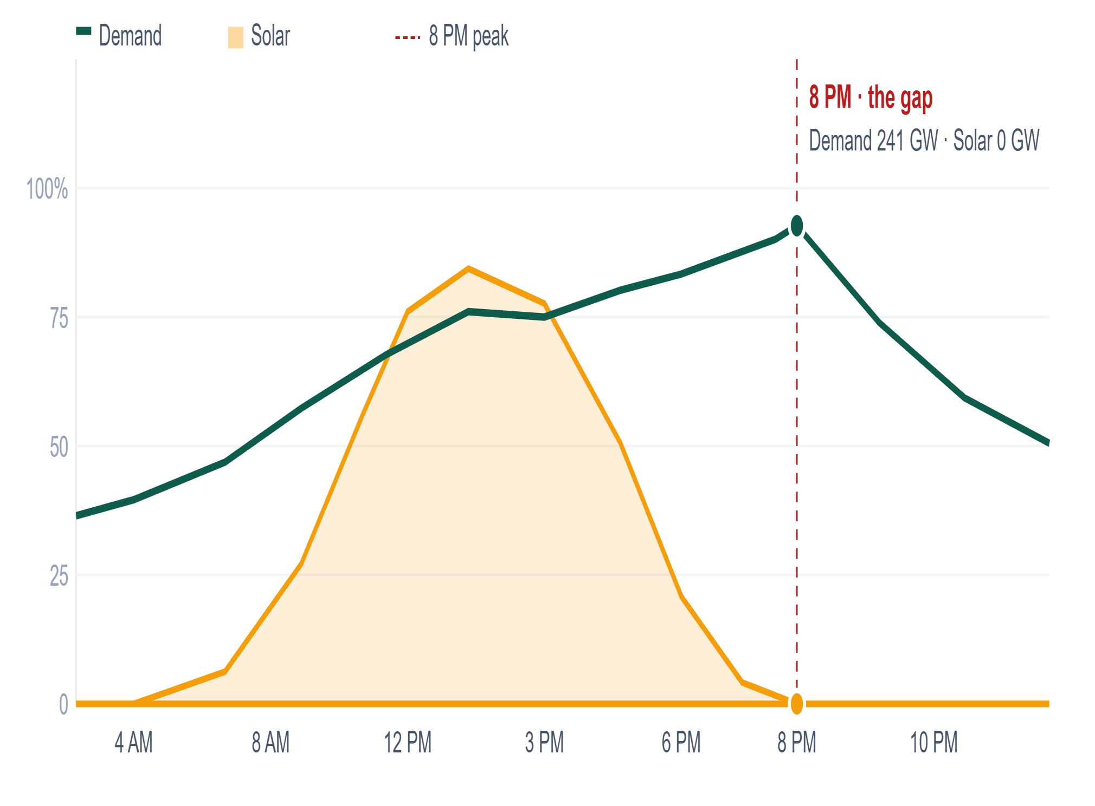
01 · THE PROBLEM
India produces enough power — not at the right time, place, or season
EXHIBIT 01 · POSOCO HOURLY LOAD · CEA DAILY RE GENERATION
1
Diurnal mismatch
Solar vs. demand — a typical day (% of peak)
Solar = 0 GW at 8 PM. Evening peak (241 GW) is entirely coal + hydro.
2
Seasonal mismatch
Wind peaks Jul–Sep (monsoon). Demand peaks Apr–Jun & Oct. ~3-month offset.
3
Geographic mismatch
Rajasthan: 28% solar capacity / 6% demand. UP: 4% capacity / 15% demand.
CUF BY SOURCE — WHY 150 GW SOLAR ≠ 150 GW COAL
Source
Avg CUF
@ 8 PM
☀ Solar
20%
0%
💨 Wind
25%
25%
⚫ Coal
58%
72%
⚛ Nuclear
82%
82%
6 AM Solar rising 40%
12 PM Solar peak 100%
3 PM Solar+Wind 80%
6 PM Solar drops 30%
8 PM Solar ZERO Demand MAX
10 PM Coal+Hydro carry all
More panels don't fix 8 PM. Storage + grid + carbon pricing do.
THESIS
Strategy & Operations
Source: POSOCO hourly load curves · CEA daily RE generation 2019–25 · NPP installed capacity
02 / 12

Slide 3
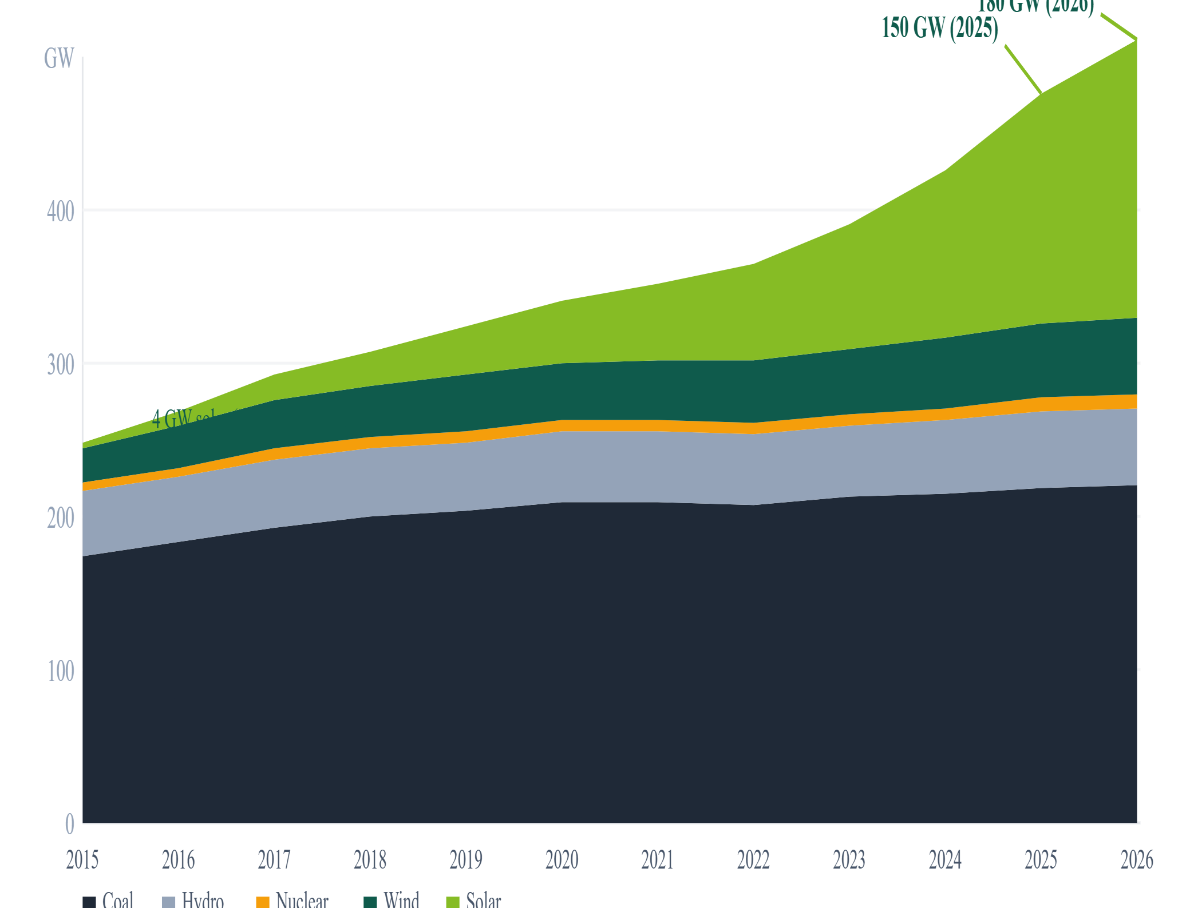
02–03 · DATA & DIAGNOSIS
9 official Govt datasets · Solar 37× in 10 years · Deficit now <1%
EXHIBIT 02 · CEA/CICERO CAPACITY SERIES 2015–2026
37 ×
42 %
India installed capacity by source (GW, stacked)
Solar growth 2015→26
Renewable cap share
<1 %
9
Energy deficit 2024–25
Official datasets
9 OFFICIAL DATASETS — ALL VIA IDP CKAN OPEN API
Dataset
Agency
Period
Daily Power Generation
NPP/CEA · IDP
2017–25
Energy Req & Availability
CEA · IDP
2001–24
Installed Capacity (State)
NPP/CEA · IDP
2014–25
Daily Coal Stocks
NPP/MoP · IDP
2014–25
Daily Power Outages
NPP/MoP · IDP
2014–25
Daily RE Generation
CEA · IDP
2019–25
National Capacity Series
CEA/POSOCO · CICERO
1947–26
POSOCO Hourly Load
POSOCO
2020–24
CEA Annual Peak Demand
CEA Annual Reports
2010–24
PROVENANCE
100% open Govt data · ODC-By licence · IDP CKAN API · No authentication required
Strategy & Operations
Source: CEA/CICERO capacity series · India Data Portal (ISB/BMGF) · NPP/MoP
03 / 12

Slide 4
04 · FIVE QUANTITATIVE MODELS
Each model answers one board-level question — linked on the same 9 datasets
FORECAST
INVENTORY
OPTIMISATION
SEGMENTATION
SCENARIO
1
2
3
4
5
SARIMAX(2,1,1)
EOQ + ROP
LP Dispatch
K-Means
BESS + Counterfactual
DEMAND · AIC=102.4
COAL STOCKS
PUPLP/CBC · 7 SOURCES
STATE CLUSTERS · k=4
STORAGE SIZING + LP
How much power will India need by 2030?
Was Oct 2021 coal crisis preventable?
Cheapest mix to meet 8 PM demand?
Do all states share the same problem?
How much storage at 500 GW solar?
15 yrs CEA data · AR2, I1, MA1 · 95% CI band
Q* = √(2DS/H) D=demand · S=₹3Cr/rake H=₹150/T/day · ROP=22d
Sources: Coal · Hydro · Wind · Solar · Nuclear · Gas · BESS Constraints: demand, cap, ramp Scenarios: ₹0/₹200/₹400/₹572 tax
Features: RES share · coal cap · deficit % · total cap StandardScaler normalisation Silhouette score = 0.61
Engineering sizing: CUF 20% · 8h/day RTE 88% · 50% stored · 4h discharge Counterfactual LP: 4 solar scenarios
241 → 295 GW
Yes — EOQ violation
200 GW coal at 8 PM
4 distinct clusters
300–500 GWh needed
+3.5% CAGR · ±31 GW CI
100+ plants · ≤4 days stock
Decarbonise: +37% w/o BESS
Each needs different policy levers
Coal still 70 GW at peak (500 GW solar)
Strategy & Operations
statsmodels SARIMAX · analytical EOQ · PuLP/CBC LP · scikit-learn KMeans · engineering BESS model
04 / 12

Slide 5
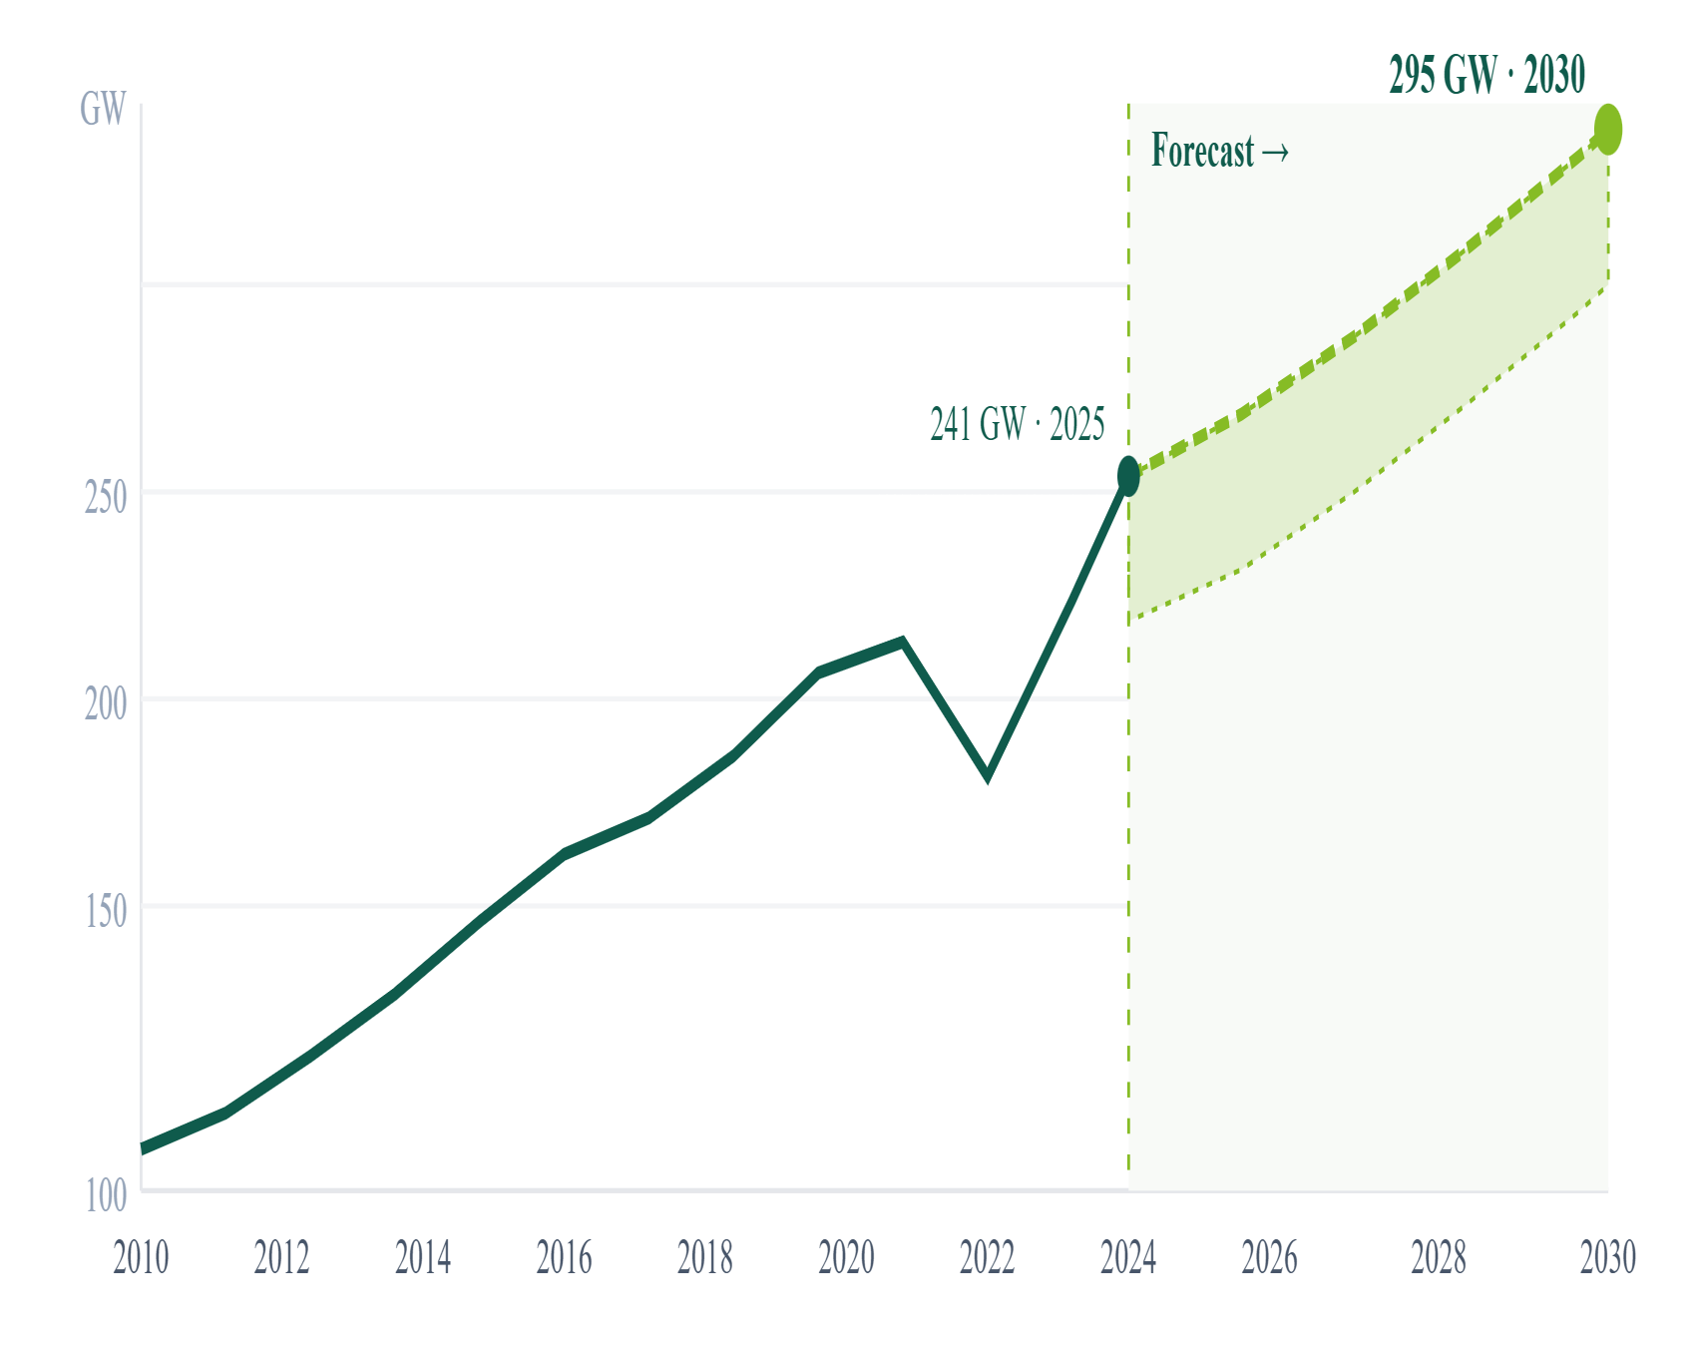
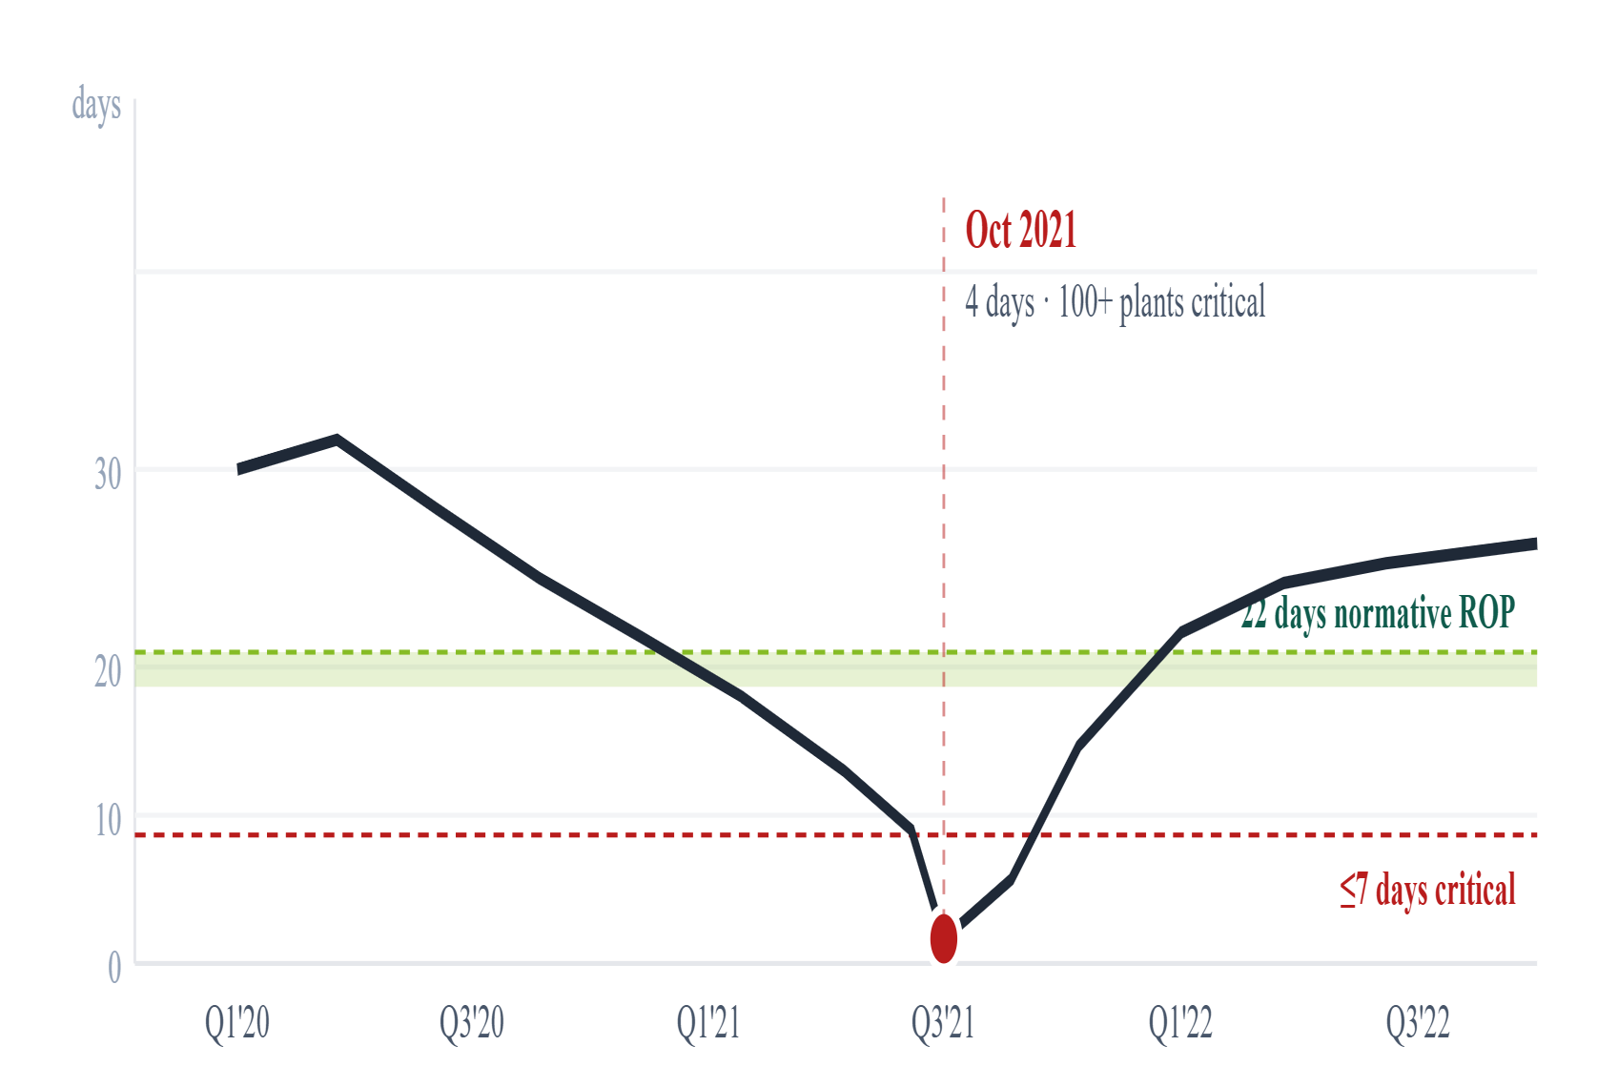
MODELS 1 & 2
Demand hits 295 GW by 2030 · Oct 2021 crisis was an EOQ violation, not a shortage
MODEL 1 · SARIMAX(2,1,1) · AIC=102.4 · 95% CI ±31 GW
MODEL 2 · EOQ + ROP · IDP COAL STOCKS (D4) · 2020–22
Peak demand: actual + forecast (GW) · 2010–2030
Thermal fleet coal stock days vs. normative (22 days)
EOQ FORMULA & VARIABLES
Q* = √(2 × D × S / H)
D = daily coal demand rate (rake/day)
S = ~₹3 Crore / rake order cost
H = ~₹150 / tonne / day holding
ROP = normative × D (= 22 days)
295
3.5%
+54
±31
DIAGNOSIS
EOQ-compliant ordering would have triggered restock 3 weeks before crisis. Cost of fix: ₹500 Cr. Benefit: prevents ₹30,000 Cr/yr GDP loss.
2030 GW
CAGR
GW above 2025
GW 95% CI
Strategy & Operations
Source: CEA Annual Reports 2010–24 · NPP/MoP daily coal stocks (IDP D4) · open CKAN API
05 / 12

Slide 6
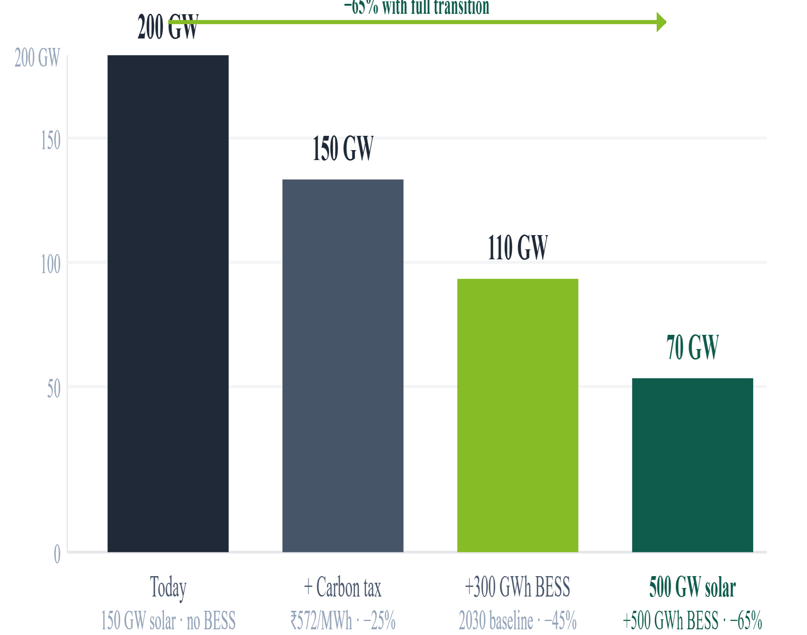
MODELS 3 & 4
500 GW solar still leaves 70 GW coal at 8 PM · 4 state clusters need distinct levers
MODEL 3 · PULP/CBC LP · 7 SOURCES · 4 CARBON SCENARIOS · POSOCO 2024
MODEL 4 · K-MEANS · K=4 BY SILHOUETTE (0.61) · STANDARDSCALER
Coal dispatched at 8 PM peak — four scenarios (GW)
4 state clusters — 4 different policy playbooks
#
Cluster
States
RE Share
Coal
Policy Priority
A
RE Champions
Rajasthan · Gujarat · Karnataka
40%+
<30%
HVDC + BESS co-location
B
Transition
TN · AP · Telangana
30–40%
35–45%
Offshore wind + demand response
C
Coal Dependent
UP · MH · MP · Jh · WB
<20%
60%+
BESS mandate + green loans
D
Energy Starved
Bihar · HP · Northeast
Varies
Low cap
VGF + microgrids
A · RE Champions
B · Transition Leaders
HVDC lines ₹45,000 Cr (self-funded)
Offshore wind (TN: 30+ GW)
BESS co-location > 500 MW solar
Priority grid upgrade funding
Waive wheeling charges 5 yrs
Demand response flatten peak
KPI: Export 50 BU/yr by 2028
KPI: +15 GW RE + 8 GWh BESS
C · Coal Dependent
D · Energy Starved
BESS mandatory with RE permit
VGF for unviable small solar
Coal PLF floor 55%→45% by 2027
Community solar microgrids
Concessional DISCOM green loans
RE-linked energy access subsidy
KPI: RES 20%→40% by 2030
KPI: Eliminate deficit by 2027
LP MODEL ASSUMPTIONS
Sources: Coal, Hydro, Wind, Solar, Nuclear, Gas, BESS
Objective: Minimise total generation cost
IMPLICATION
One-size-fits-all policy misses ₹40,000+ Cr/yr of efficiency gains. Cluster-specific levers are essential.
Constraints: Demand met, capacity ceiling, ramp
Solver: PuLP / CBC open-source LP
Strategy & Operations
Source: PuLP/CBC LP · scikit-learn KMeans · POSOCO 2024 hourly load · CEA state capacity data
06 / 12

Slide 7
MODEL 5 · BESS SIZING + COUNTERFACTUAL
India needs 300–500 GWh of storage — 75–125× today · ₹12,000 Cr initial capex
EXHIBIT · ENGINEERING SIZING MODEL · CEA RE GENERATION · INDUSTRY RTE BENCHMARKS
~4 GWh
300–500 GWh
Step-by-step: 150 GW solar nameplate → BESS power capacity required
Requirement
#
Step
Factor
Running Result
India BESS today
1
Solar installed capacity (2025)
—
150 GW
75–125 ×
₹12k Cr
The gap
Initial capex
2
× Average annual CUF
× 20%
30 GW effective
5B COUNTERFACTUAL — COAL AT 8PM IN 4 SCENARIOS
3
× Daily production hours
× 8 h/day
—
200
150
110
70
Today 150 GW solar
+Carbon tax ₹572/MWh
+300 GWh BESS
500 GW +500 GWh
4
= Daily solar generation
—
240 GWh/day
Key finding: Coal does not disappear at peak even at 500 GW solar + 500 GWh BESS. Full decarbonisation requires >800 GWh or clean dispatchable alternatives.
5
× Fraction stored for evening
× 50%
120 GWh
6
× Round-trip efficiency (Li-ion)
× 88%
—
7
= Usable energy for 8 PM peak
—
106 GWh
8
÷ Required discharge duration
÷ 4 h
—
9
= BESS power capacity needed
—
26 GW
National estimate (load variability + reserve + geography): 300–500 GWh · Initial 30 GWh tranche capex: ~₹12,000 Crore
IMPLICATION
75–125× gap cannot close via markets alone. Policy mandates + VGF + concessional capital essential.
Strategy & Operations
Engineering model · CEA daily RE generation 2019–25 · RTE benchmark 88% · PuLP counterfactual
07 / 12

Slide 8
05 · ECONOMIC ANALYSIS
BESS NPV +₹11.7k Cr · Coal underpriced ₹572/MWh · Solar ₹1.5/kWh at 400 GW
EXHIBIT 09A · CBA · 25-YEAR · 10% WACC
EXHIBIT 09B · PIGOUVIAN ANALYSIS · CICERO EMISSIONS INTENSITY
EXHIBIT 09C · WRIGHT'S LAW · 28% LEARNING RATE · IRENA BENCHMARK
BESS investment NPV waterfall (₹k Crore)
Coal market price vs. social cost (₹/MWh)
Solar LCOE vs. cumulative capacity (₹/kWh)
Component
₹k Cr
Notes
Component
₹/MWh
Year
Cum. GW
LCOE
Note
Capex (30 GWh · ₹4 Cr/MWh)
−12.0
FY2026 outlay
Market price of coal generation
2,175
2014
~10
₹4.50
Early installs
Peak savings (PV, 25 yr)
+18.0
vs. gas peakers ₹8/kWh
+ CO₂ emissions damage
+390
2020
~40
₹3.00
Competitive auctions
Ancillary revenue (PV)
+4.0
Freq. reg + spinning reserve
+ Air quality (PM2.5, NOₓ, SOₓ)
+127
2025
150
₹2.20
Current
Opex (PV)
−3.0
Maintenance + insurance
+ Water usage externality
+55
2028 (fcst)
~300
₹1.80
Beats coal market
Terminal value (PV)
+5.0
Cell recycling + repurpose
Social cost (true)
2,747
2030 (fcst)
400
₹1.50
Cheapest ever
Net Present Value
+11.7
Robust ±20% cost swing
Pigouvian tax = social cost − market price
At ₹1.5/kWh vs coal social cost ₹2.747/kWh:
₹572/MWh gap
₹1.247/kWh advantage
Coal underpriced by 26% of true cost
~₹80,000 Cr/yr system-level savings at 400 GW
+₹11.7k Cr
₹80,000 Cr/yr
₹1.5/kWh
NPV positive · payback 7.1 years @ 10% WACC
Revenue at ₹572/MWh · funds P1 & P2 simultaneously from Day 1
Solar at 400 GW · cheapest energy in India's history
Strategy & Operations
Source: BESS CBA model · CICERO emissions intensity · WHO air quality damage · IRENA 28% learning rate
08 / 12

Slide 9
06 · POLICY RECOMMENDATIONS
Five actions — costed, owned, time-bound — cut coal at 8 PM by 65% by 2030
PRIORITY
ACTION & MECHANISM
KEY IMPACT
COST / RETURN
OWNER · TIMELINE
P1 · HIGH
Mandate 300 GWh BESS by 2030
NPV +₹11.7k Cr · 7.1yr payback · cuts coal −65% at peak · 300 GWh target
Capex: ₹12,000 Cr Funded by P3 carbon tax Day 1
MNRE + MoP FY25 announce · FY26 tender
VGF · competitive BESS tenders · DISCOM must-buy obligation · PLI domestic mfg
P2 · HIGH
Fast-track inter-state HVDC grid
Unlocks ₹60,000 Cr/yr stranded Rajasthan RE · cuts grid losses
₹45,000 Cr / 5 yrs Self-funded via wheeling revenue
MoP / PowerGrid Transmission plan Q2 FY26
Green Energy Corridors Phase 3 · PowerGrid mandate · TBCB competitive bids
P3 · MED
Pigouvian carbon tax ₹572/MWh on coal
₹80,000 Cr/yr revenue · corrects ₹2,747/MWh social cost failure
Revenue-positive Day 1 Funds P1 + P2 in full
Ministry of Finance Union Budget 2026–27
Environment cess on coal power · revenue → Green Transition Fund · BESS + grid
P4 · MED
Accelerate solar to 400 GW by 2028
LCOE → ₹1.8/kWh by 2028 · beats coal social cost ₹2,747/MWh
₹30k Cr subsidies → ₹80k Cr/yr LCOE savings
MNRE NEP revision · annual targets
PM-KUSUM expansion · Rooftop Solar 2.0 · PLI manufacturing push
P5 · LOW
Enforce EOQ coal inventory norms
Prevents Oct'21 repeat · protects ₹30,000 Cr/yr GDP from grid disruption
₹500 Cr implementation Highest ROI of all 5 policies
CEA / MoP Notification within 6 months
NPP real-time ROP alert · penalty for stock < normative_stock_days · CEA notification
Strategy & Operations
Source: BESS CBA · Pigouvian analysis · Wright's Law · LP dispatch · EOQ coal norms
09 / 12

Slide 10
07 · IMPLEMENTATION ROADMAP 2025–2030
₹3.65 lakh Cr build plan — ₹80,000 Cr/yr ceiling never breached
Multi-period LP: min NPV cost · demand met each year · ramp constraints · 5–7%/yr solar learning-curve savings incorporated
Year
Solar +GW
Wind +GW
BESS Added
Annual Capex (₹ Cr)
Cumul. Solar (GW)
Budget Used
218 GW
62 GW
2025
28
8
2 GW · 8 GWh
42,000
178
53%
Solar added 2025–30
Wind added
2026
32
9
3 GW · 12 GWh
51,000
210
64%
2027
38
10
4 GW · 16 GWh
62,000
248
78%
96 GWh
368 GW
2028
40
11
5 GW · 20 GWh
68,000
288
85%
BESS by 2030
Cumulative solar
2029
40
12
5 GW · 20 GWh
70,000
328
88%
2030
40
12
5 GW · 20 GWh
72,000
368
90%
LP CONSTRAINTS
TOTAL
218
62
24 GW · 96 GWh
3,65,000
368
Ceiling: ₹80k
Budget ceiling: ₹80,000 Cr/yr — never breached
Demand: met every year under SARIMAX forecast
ANNUAL CAPEX VS. ₹80,000 CRORE BUDGET CEILING
Ramp constraints: engineering limits on new builds
Solar learning: 5–7%/yr cost decline incorporated
Objective: minimise NPV cost over 6-year horizon
OUTCOME
368 GW solar + 24 GW BESS at ₹3.65 lakh Cr total. Coal at 8 PM: 200 → 110 GW by 2030.
Strategy & Operations
Multi-period LP · min NPV(cost) · budget ₹80,000 Cr/yr · demand, ramp, learning constraints
10 / 12

Slide 11
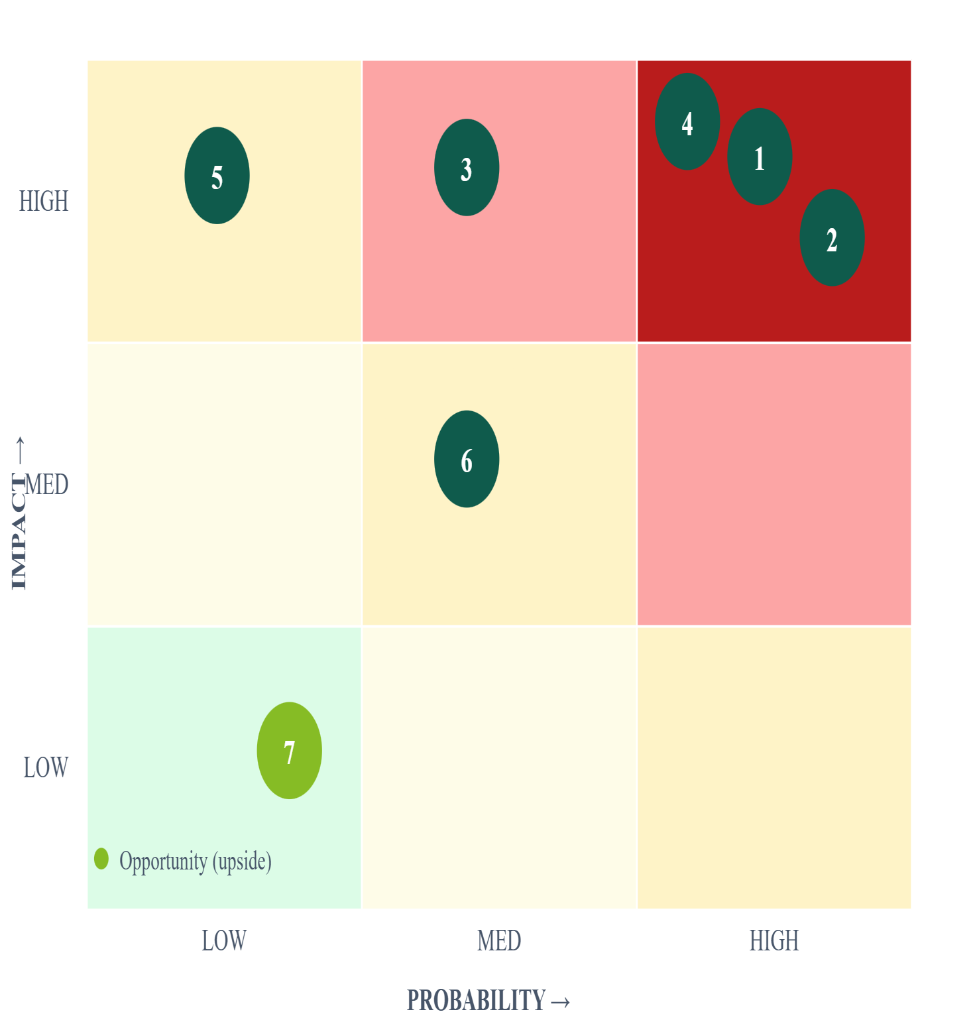
08 · RISKS & MITIGATION
7 risks ranked by probability × impact — two require immediate board attention
EXHIBIT 12 · 3×3 HEAT-MAP · PROBABILITY × IMPACT
#
Prob/Impact
Risk
Mitigation
1
HI · HI
BESS costs remain high
VGF + import duty waiver + PLI for domestic BESS manufacturing
Threatens entire P1 programme
2
HI · HI
Grid not upgraded in time
PowerGrid mandate + tariff reform for transmission investment
Strands Rajasthan RE surplus
3
MD · HI
Demand grows faster than SARIMAX
Demand response programmes + building energy efficiency mandates
+31 GW CI upper bound by 2030
4
HI · HI
DISCOM resistance to BESS mandate
Must-buy regulation + DISCOM payment security mechanism
Payment security concerns
5
LO · HI
Coal PLF collapse (financial crisis)
Minimum offtake guarantee for coal plants during transition period
Cluster C state utilities at risk
6
MD · MD
Policy reversal post-election
Embed BESS targets in NEP as statutory requirements
BESS targets are discretionary
7
LO · LO
Technology breakthrough (UPSIDE)
Build flexibility clauses into all contracts — avoid technology lock-in
e.g. solid-state BESS cost halves
Strategy & Operations
Authors' risk register · cross-referenced NITI Aayog energy risk framework
11 / 12

Slide 12
10
COMPLETE EVIDENCE CHAIN — 10 QUESTIONS, 10 MODEL-BACKED ANSWERS
Q01
Did renewables solve the capacity gap?
Wk1 · CEA
Yes — 42% share, deficit <1%
Q02
Is solar available at the 8 PM peak?
Wk2 · POSOCO
No — 0 GW, every single day
Q03
India peak demand in 2030?
Wk3 · SARIMAX
FINAL THESIS · 4 WKS · 9 DATASETS · 5 MODELS · 1 ANSWER
295 GW (+3.5% CAGR) · ±31 GW CI
Renewables solved the capacity gap.
Q04
Cheapest dispatch at 8 PM?
Wk3 · LP
200 GW coal today · 70 GW with BESS
Q05
Was Oct 2021 a coal shortage?
Wk3 · EOQ
No — EOQ supply chain failure (100+ plants · 4 days)
Q06
Do all states share the same problem?
Wk3 · KMeans
Storage solves the timing gap.
No — 4 distinct clusters (silhouette=0.61)
Q07
Is BESS investment financially justified?
Wk4 · CBA
Yes — NPV +₹11,700 Cr @ 10% WACC · 7.1yr payback
Q08
Is coal priced correctly?
Wk4 · Pigou
No — underpriced ₹572/MWh vs. social cost ₹2,747
Policy makes it happen.
Q09
Solar LCOE at 400 GW?
Wk4 · Wright
₹1.5/kWh — cheapest energy in India's history
Q10
Does 500 GW solar eliminate coal at peak?
Wk4 · Counter-LP
No — coal 200 → 70 GW (not zero). Needs BESS + tax.
5 models: 300 GWh BESS + ₹572/MWh carbon tax + LP build plan → coal 8 PM: 200 GW → 70 GW by 2030 (−65%)
TOP 5 POLICIES
P1: 300 GWh BESS mandate · NPV +₹11.7k Cr
P2: HVDC grid fast-track · ₹45,000 Cr self-funded
P3: ₹572/MWh carbon tax · ₹80k Cr/yr revenue
P4: Solar 400 GW by 2028 · LCOE ₹1.8/kWh
P5: EOQ coal norms · prevents ₹30k Cr GDP loss
W1 DATA 9 datasets · solar 37× · deficit <1%
W2 DIAGNOSIS 3 mismatches · solar=0 @ 8pm
W3 MODELS SARIMAX · EOQ · LP · K-Means
W4 ECONOMICS CBA · Pigou · Wright · LP plan
STRATEGY & OPERATIONS PRACTICE
India Data Portal · CEA · NPP · POSOCO · CICERO · All official Govt of India
12 / 12

